Slide 1


Cross-Stream Migration of a Rigid Sphere in 2-D Poiseuille Flow in 2nd Order Fluids
Flow - Focusing of forced v/s force-free Techniques
- Soumyodeep Chowdhury
- 241020033

Slide 2
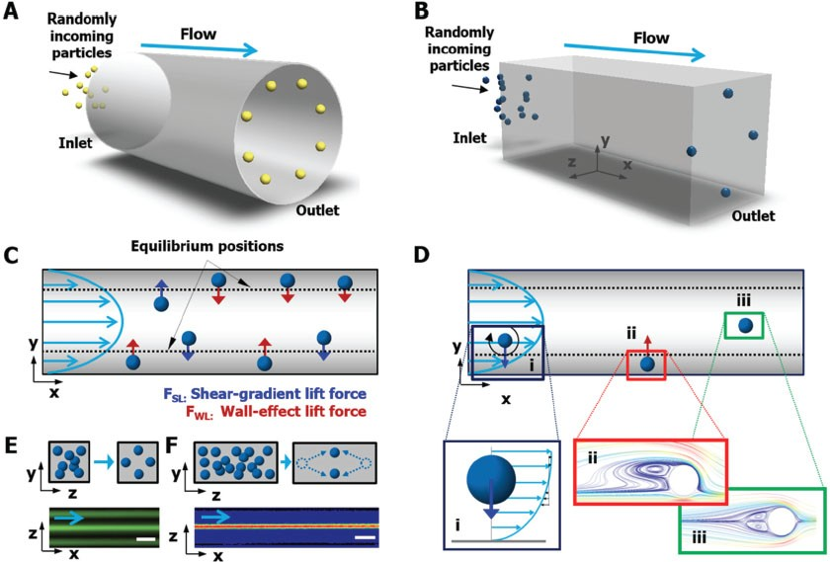
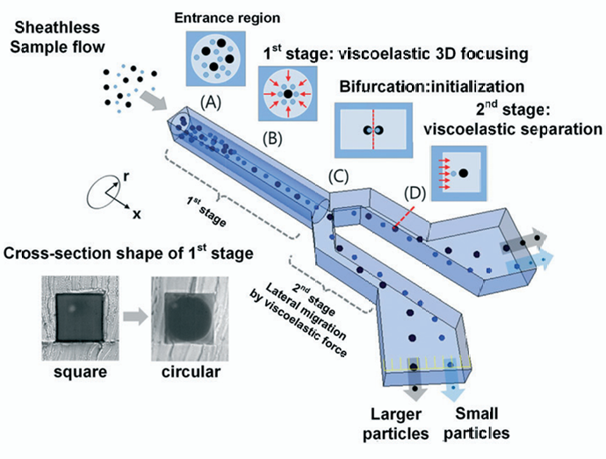
Cross Stream Migration
Cross-stream migration can occur due to inertial effects in Newtonian flows as well as in non-Newtonian flows (Viscoelastic Fluids) due to Normal stress differences.
Image Sources: Lab Chip,2018,18,551.

Slide 3
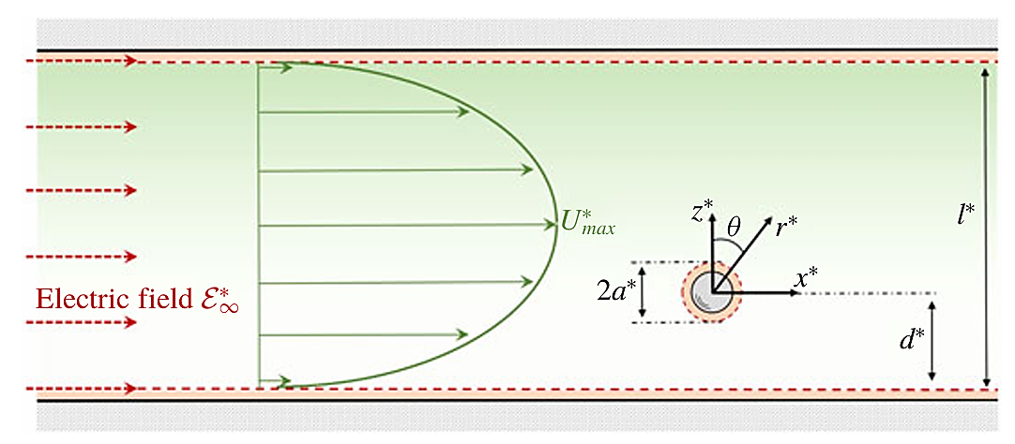
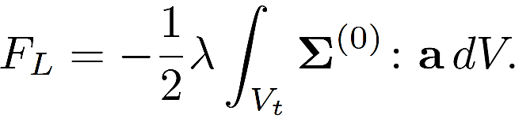
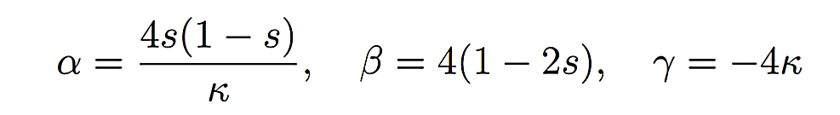
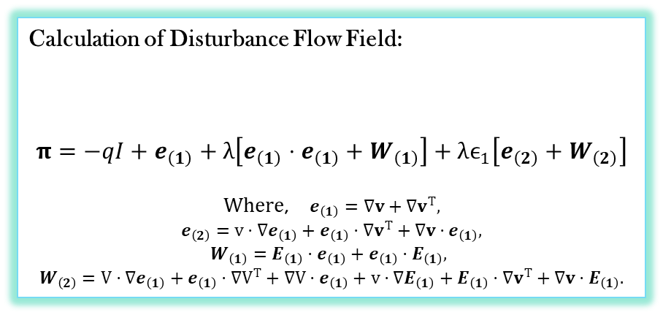
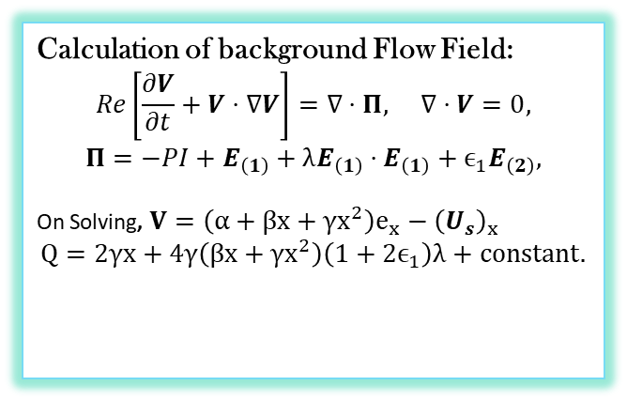
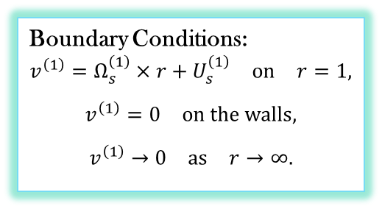

Viscoelastic Migration
Boundary Conditions:
$$v^{\left(1\right)}=Ω_{s}^{\left(1\right)}×r+U_{s}^{\left(1\right)} \text{on} r=1,$$
$$v^{\left(1\right)}=0 \text{on} \text{the} \text{walls},$$
$$v^{\left(1\right)}→0 \text{as} r→∞.$$
Using Lorentz Reciprocal Theorem
Calculation of background Flow Field:
$$Re\left[\frac{∂V}{∂t}+V⋅∇V\right]=∇⋅Π, ∇⋅V=0,$$
$$Π=−PI+E_{\left(1\right)}+λE_{\left(1\right)}⋅E_{\left(1\right)}+ϵ_{1}E_{\left(2\right)},$$
On Solving, $V=\left(α+βx+γx^{2}\right)e_{x}−{\left(U_{s}\right)}_{x}$
$$Q=2γx+4γ\left(βx+γx^{2}\right)\left(1+2ϵ_{1}\right)λ+\text{constant}.$$
Calculation of Disturbance Flow Field:
$$π=−qI+e_{\left(1\right)}+λ\left[e_{\left(1\right)}⋅e_{\left(1\right)}+W_{\left(1\right)}\right]+λϵ_{1}\left[e_{\left(2\right)}+W_{\left(2\right)}\right]$$
Where, $e_{\left(1\right)}=∇v+∇v^{T},$
$$e_{\left(2\right)}=v⋅∇e_{\left(1\right)}+e_{\left(1\right)}⋅∇v^{T}+∇v⋅e_{\left(1\right)},$$
$W_{\left(1\right)}=E_{\left(1\right)}⋅e_{\left(1\right)}+e_{\left(1\right)}⋅E_{\left(1\right)},$
$$W_{\left(2\right)}=V⋅∇e_{\left(1\right)}+e_{\left(1\right)}⋅∇V^{T}+∇V⋅e_{\left(1\right)}+v⋅∇E_{\left(1\right)}+E_{\left(1\right)}⋅∇v^{T}+∇v⋅E_{\left(1\right)}.$$
$$∇⋅π=0$$
$$∇⋅v=0$$
Schematic Source: Choudhary A, Pushpavanam S ,.JFM.2019.479.

Slide 4
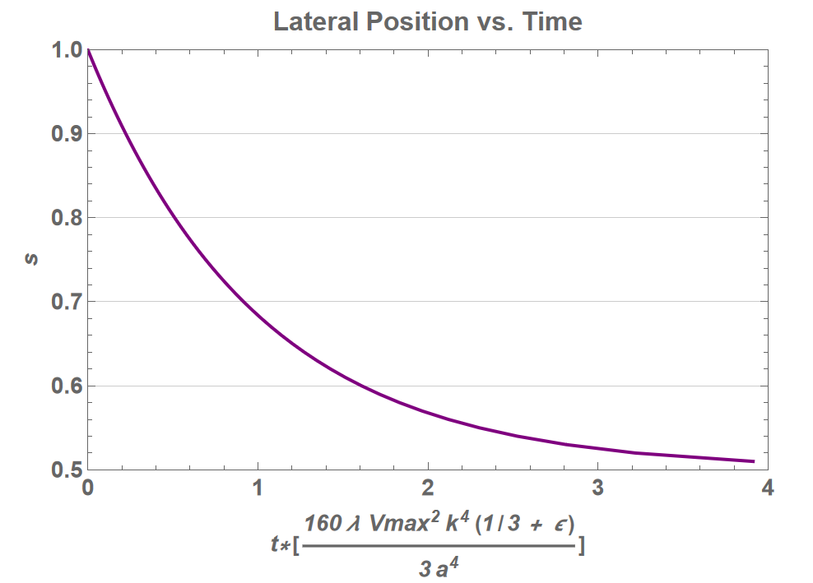
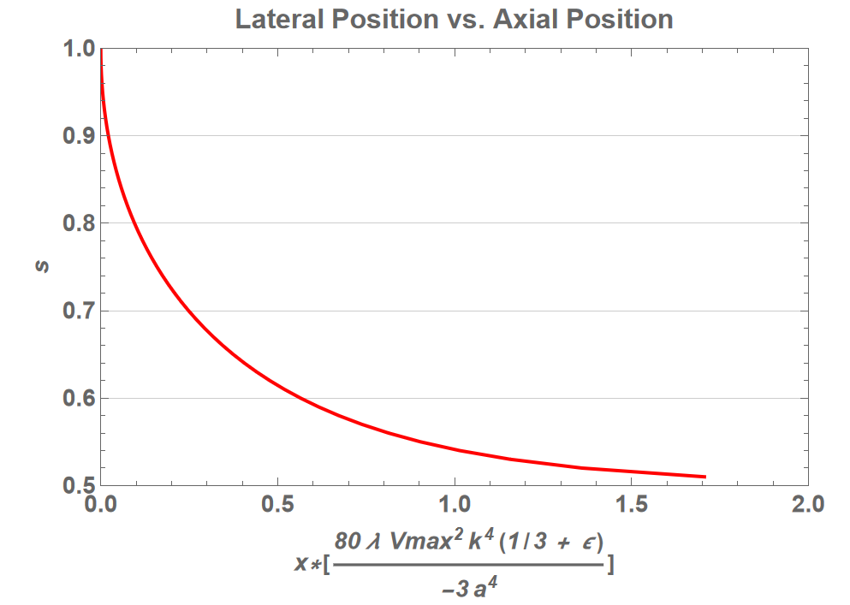
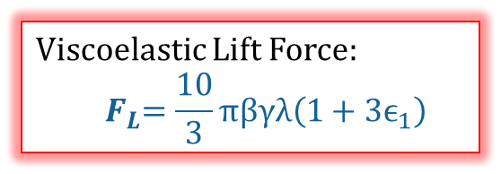
Viscoelastic Migration
Viscoelastic Lift Force:
$${ F}_{L}=\frac{10}{3}πβγλ\left(1+3ϵ_{1}\right)$$
Particle Trajectories with Time and Axial Position

Slide 5
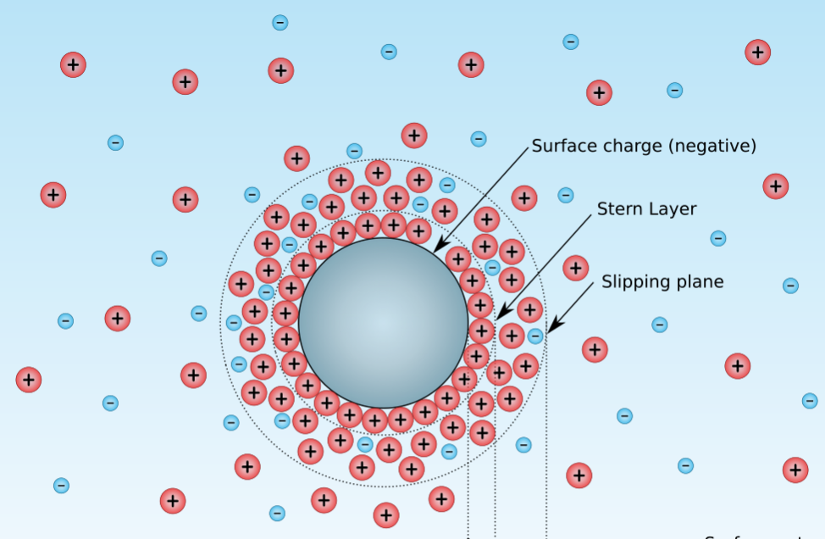
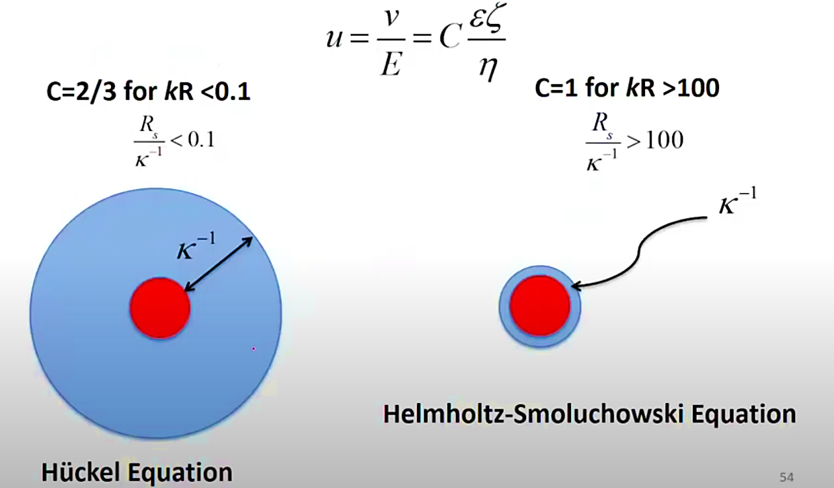
Electrophoresis (Force-Free Technique)
Electrical Double Layer: When a particle is immersed in an electrolytic medium, a thin diffuse layer of counter ions is formed which is called the EDL.
Electrophoresis: When an external field is applied in these systems, the diffuse layer then slips resulting in force free motion of the particle known as Electrophoresis.

Slide 6
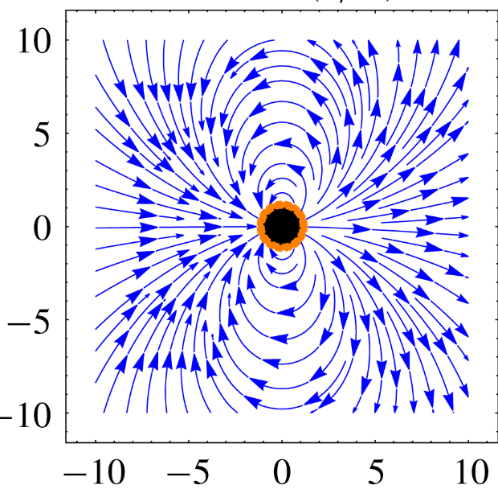
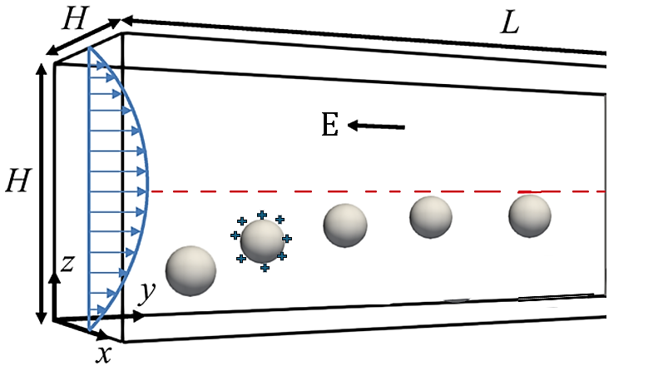
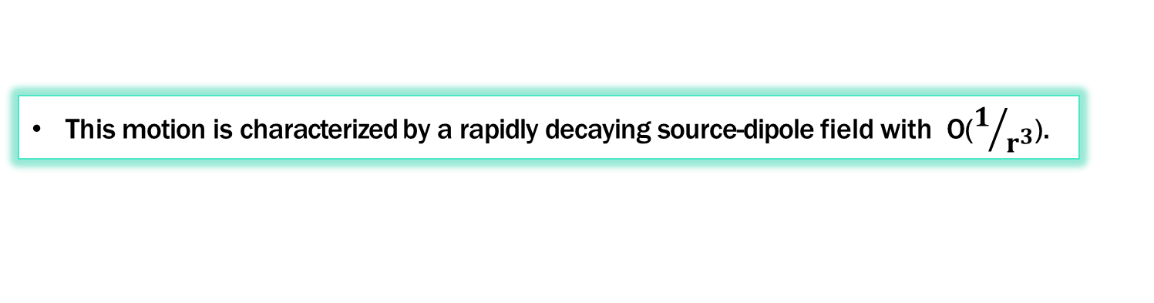
Electrophoretic Particle Migration
This motion is characterized by a rapidly decaying source-dipole field with O($1/{r^{3}}$).

Slide 7
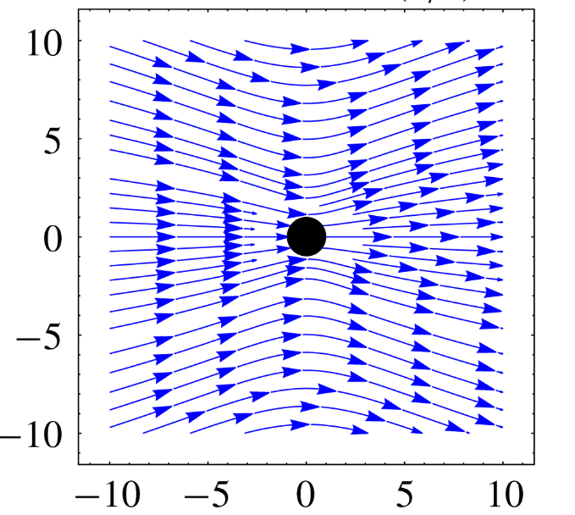
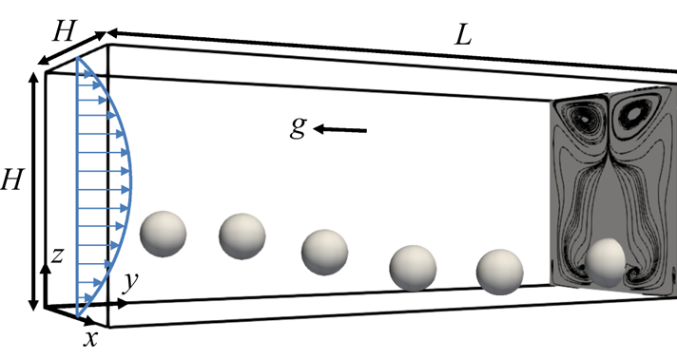
Sedimentation (Forced Migration Technique)
When particles sediment under the action of direct gravitational field, their hydrodynamics signature is same as Stokeslet (~O(1/r)).

Slide 8
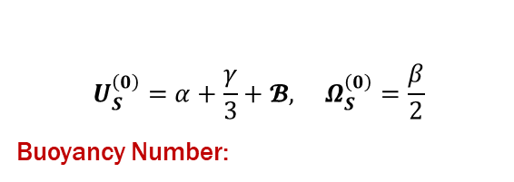
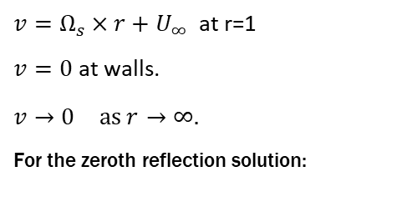

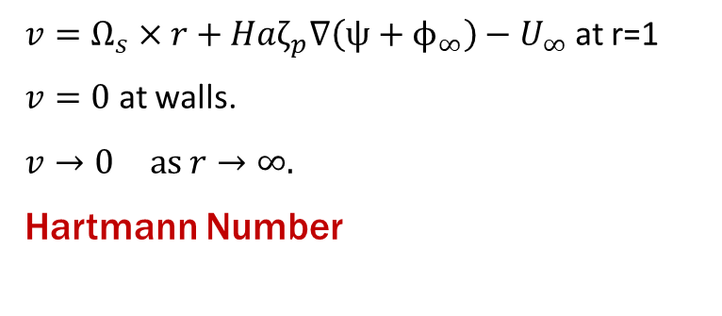
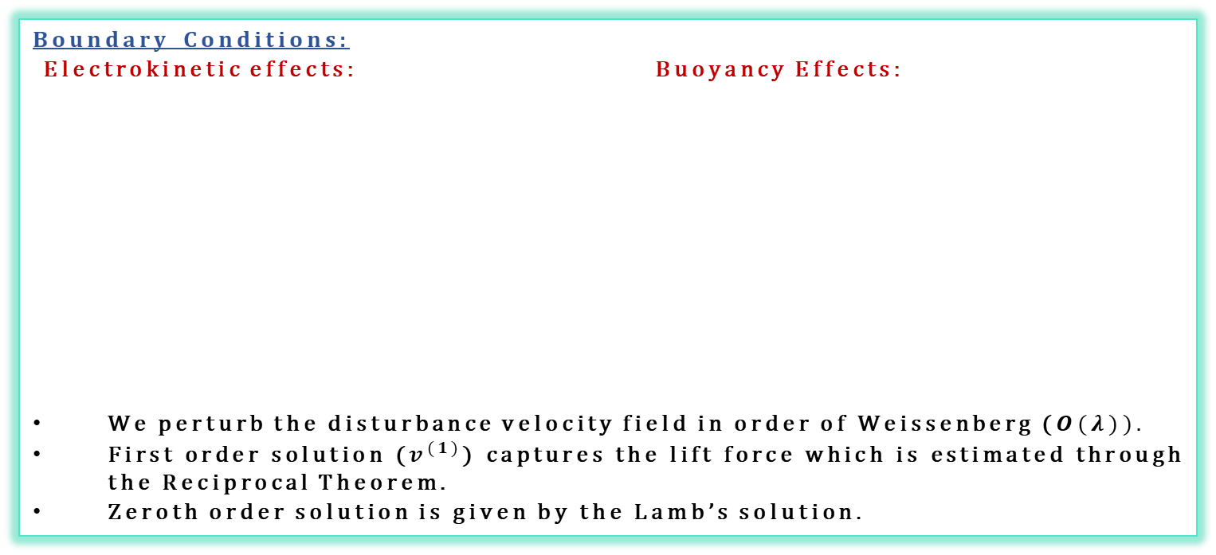

Solution Techniques
Boundary Conditions:
Electrokinetic effects: Buoyancy Effects:
We perturb the disturbance velocity field in order of Weissenberg ($O(λ)).$
First order solution ($v^{(1)}$) captures the lift force which is estimated through the Reciprocal Theorem.
Zeroth order solution is given by the Lamb’s solution.
$v=Ω_{s}×r+Haζ_{p}∇\left(ψ+ϕ_{∞}\right)−U_{∞}$ at r=1
$v=0$ at walls.
$v→0 \text{as} r→∞.$
Hartmann Number:
$v=Ω_{s}×r+U_{∞}$ at r=1
$v=0$ at walls.
$v→0 \text{as} r→∞.$
For the zeroth reflection solution:
$$U_{S}^{\left(0\right)}=α+\frac{γ}{3}+𝓑, Ω_{S}^{\left(0\right)}=\frac{β}{2}$$
Buoyancy Number:
$$Ha=\frac{ε^{∗}ℰ_{∞}^{∗2}a^{∗}}{4πμ^{∗}κU_{max}^{∗}}$$
$$𝓑=\frac{Δρ^{∗}\left(\frac{4π{a^{∗}}^{3}}{3}\right)g^{∗}}{6πμ^{∗}a^{∗}U_{max}^{∗}κ}.$$
Note: During the solution of the Lateral Migration force, we observed that the Electrokinetic and Buoyancy influence can be imposed if we modify just the BCs.

Slide 9
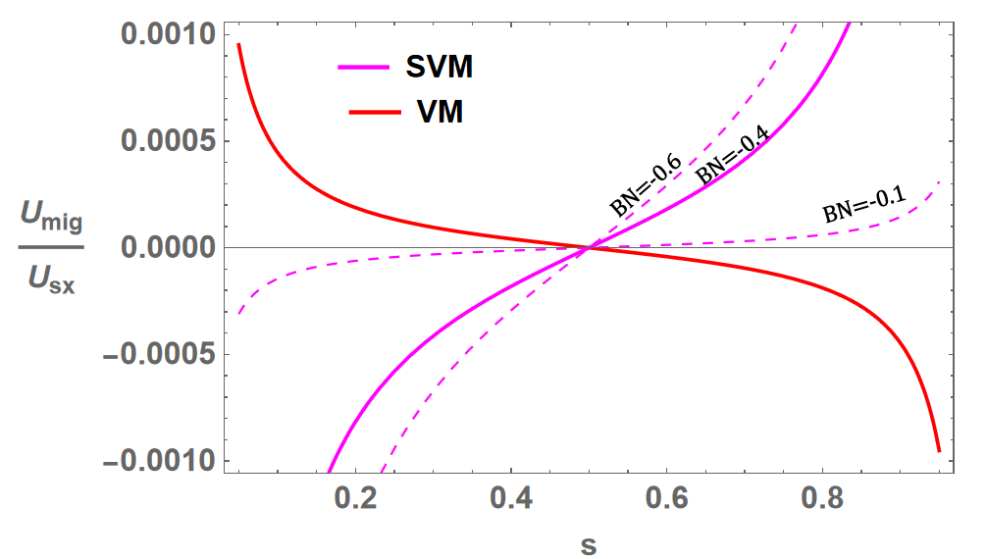
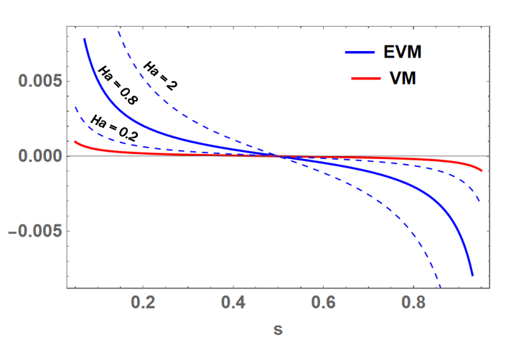
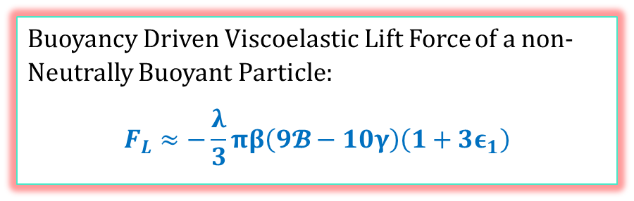
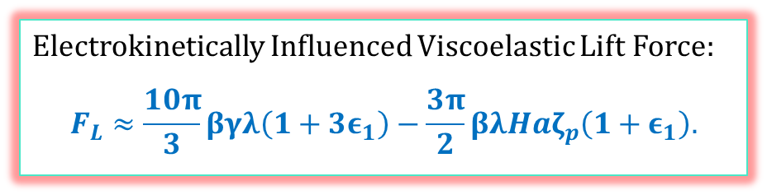
Results
Electrokinetically Influenced Viscoelastic Lift Force:
$$F_{L}≈\frac{10π}{3}βγλ\left(1+3ε_{1}\right)−\frac{3π}{2}βλHaζ_{p}\left(1+ε_{1}\right).$$
Buoyancy Driven Viscoelastic Lift Force of a non-Neutrally Buoyant Particle:
$$F_{L}≈−\frac{λ}{3}πβ\left(9𝓑−10γ\right)\left(1+3ε_{1}\right)$$

Slide 10
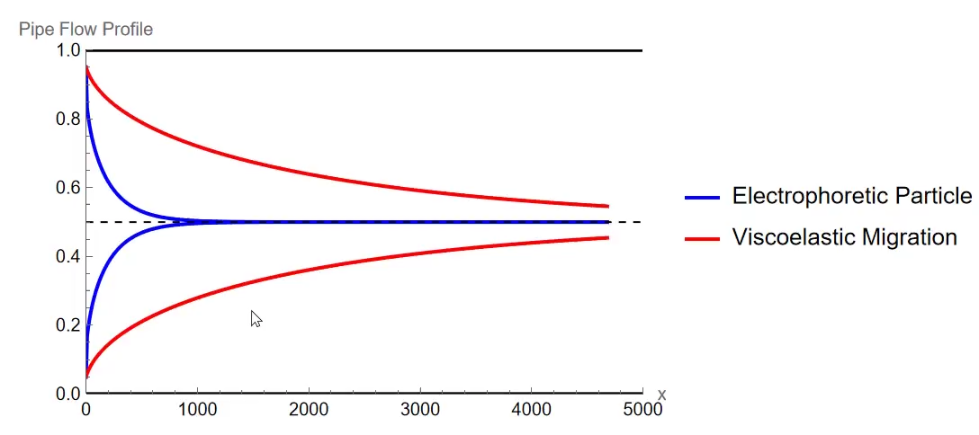
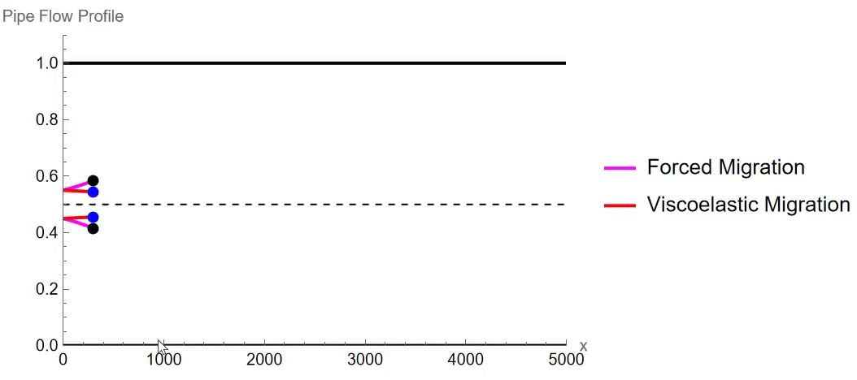
Particle Trajectories

Slide 11
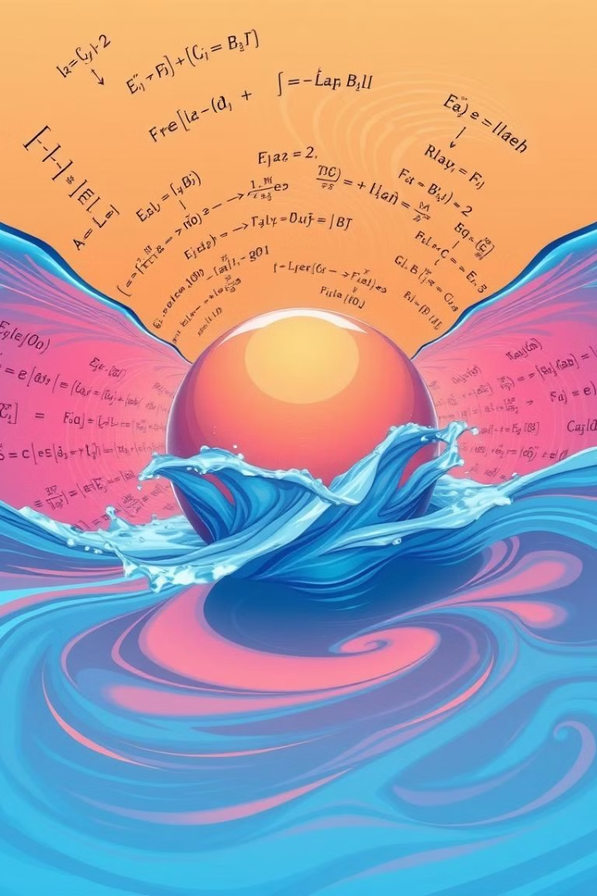
Conclusion
Key Findings
Electrokinetically driven flows lead the Plain Viscoelastic migration significantly.
It seems sediment sphere’s migration is just the opposite to that of the electrophoretic sphere.
Future Directions
Finding out the reason of this weird behavior by solving the first order velocity field(flow field) and then from there find the force from conventional ways and compare the results.

Slide 12
Updates and Doubts
Updates:
Derived velocity and pressure of a sedimenting particle and straining using Matte in mathematica.
Evaluated force on a settling particle using index notation in mathematica.
Tried and understood Peery’s general approach code on solving a sedimenting and straining particle velocity and pressure.
Doubts:
Mismatch in the final result of force but both are correct.
Unable to fully understand Peery’s SOF approach and then onwards inertia test and all.
Read Peery’s thesis but unable to understand the derivations of homogenous and particular solution velocities of zeroth order and first order approximation.
Same issue with Ganesh Subramanian’s paper appendix as both are quite related.
Not able to solve and figure out Inertia test part of flow fields code of mathematica.

Slide 13
References
Choudhary A, Renganathan T, Pushpavanam S. Inertial migration of an electrophoretic rigid sphere in a two-dimensional Poiseuille flow. Journal of Fluid Mechanics. 2019;874:856-890. doi:10.1017/jfm.2019.479.
Choudhary A, Li D, Renganathan T, Xuan X, Pushpavanam S. Electrokinetically enhanced cross-stream particle migration in viscoelastic flows. Journal of Fluid Mechanics. 2020;898:A20. doi:10.1017/jfm.2020.397.
Ho BP, Leal LG. Migration of rigid spheres in a two-dimensional unidirectional shear flow of a second-order fluid. Journal of Fluid Mechanics. 1976;76(4):783-799. doi:10.1017/S002211207600089X.
Guazzelli É, Morris JF, Pic S. Frontmatter. In: A Physical Introduction to Suspension Dynamics. Cambridge Texts in Applied Mathematics. Cambridge University Press; 2011.

